Slide 1
UVa 11582 Colossal Fibonacci Numbers!

Slide 2
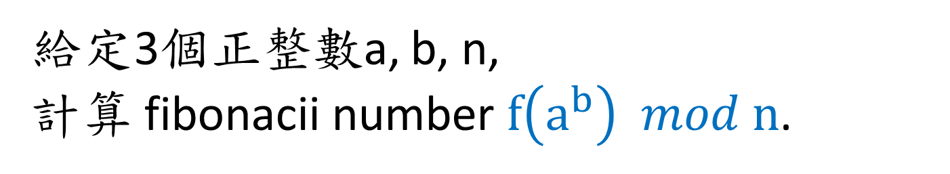


UVa 11582 Colossal Fibonacci Numbers! (Time Limit: 1 second)
給定3個正整數a, b, n,
計算 fibonacii number $f\left(a^{b}\right) mod n$.
Fibonacii number $f\left(i+2\right)=f\left(i+1\right)+f\left(i\right) for every i≥0$
where $f\left(0\right)=0 and f\left(1\right)=1$
$$0 ≤a, b≤2^{64}$$
a and b will not both be zero.
$$1 ≤n≤1000$$

Slide 3
Fibonacii Number f(i)
i | 0 | 1 | 2 | 3 | 4 | 5 | 6 | 7 | 8
f(i) | 0 | 1 | 1 | 2 | 3 | 5 | 8 | 13 | 21
i | 9 | 10 | 11 | 12 | 13 | 14 | 15 | 16
f(i) | 34 | 55 | 89 | 144 | 233 | 377 | 610 | 987
i | 17 | 18 | 19 | 20 | 21 | 22 | 23 | 24
f(i) | 1597 | 2584 | 4181 | 6765 | 10946 | 17711 | 28657 | 46368
i | 25 | 26 | 27 | 28 | 29 | 30 | 31 | 32
f(i) | 75025 | 121393 | 196418 | 317811 | 514229 | 832040 | 1346269 | 2178309

Slide 4




Sample Input
# of Test Cases
Sample Output
3
1 1 2
2 3 1000
18446744073709551615 18446744073709551615 1000
a, b, n
Fibonacii number $f\left(a^{b}\right) mod n$
1
21
250
$$0 ≤a, b≤2^{64}$$
a and b will not both be zero.
$$1 ≤n≤1000$$
Fibonacii number $f\left(i+2\right)=f\left(i+1\right)+f\left(i\right) for every i≥0$
where $f\left(0\right)=0 and f\left(1\right)=1$
Output: Fibonacii number $f\left(a^{b}\right) mod n$

Slide 5
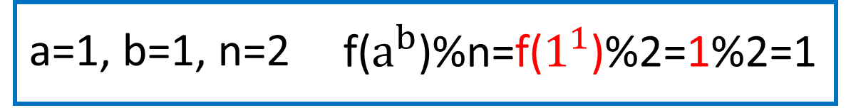
Example 1
Fibonacii Number f(i)
i | 0 | 1 | 2 | 3 | 4 | 5 | 6 | 7 | 8
f(i) | 0 | 1 | 1 | 2 | 3 | 5 | 8 | 13 | 21
i | 9 | 10 | 11 | 12 | 13 | 14 | 15 | 16
f(i) | 34 | 55 | 89 | 144 | 233 | 377 | 610 | 987
i | 17 | 18 | 19 | 20 | 21 | 22 | 23 | 24
f(i) | 1597 | 2584 | 4181 | 6765 | 10946 | 17711 | 28657 | 46368
i | 25 | 26 | 27 | 28 | 29 | 30 | 31 | 32
f(i) | 75025 | 121393 | 196418 | 317811 | 514229 | 832040 | 1346269 | 2178309

Slide 6
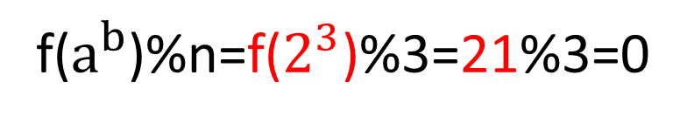
Example 2
Fibonacii Number f(i)
i | 0 | 1 | 2 | 3 | 4 | 5 | 6 | 7 | 8
f(i) | 0 | 1 | 1 | 2 | 3 | 5 | 8 | 13 | 21
i | 9 | 10 | 11 | 12 | 13 | 14 | 15 | 16
f(i) | 34 | 55 | 89 | 144 | 233 | 377 | 610 | 987
i | 17 | 18 | 19 | 20 | 21 | 22 | 23 | 24
f(i) | 1597 | 2584 | 4181 | 6765 | 10946 | 17711 | 28657 | 46368
i | 25 | 26 | 27 | 28 | 29 | 30 | 31 | 32
f(i) | 75025 | 121393 | 196418 | 317811 | 514229 | 832040 | 1346269 | 2178309
a=2, b=3, n=3
f($a^{b}$)%n=f($2^{3}$)%3=21%3=0

Slide 7
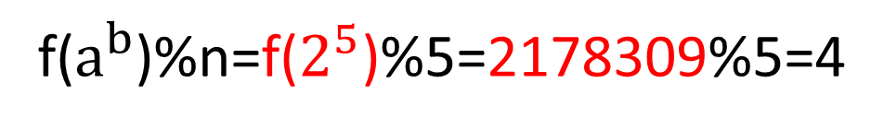
Example 3
Fibonacii Number f(i)
i | 0 | 1 | 2 | 3 | 4 | 5 | 6 | 7 | 8
f(i) | 0 | 1 | 1 | 2 | 3 | 5 | 8 | 13 | 21
i | 9 | 10 | 11 | 12 | 13 | 14 | 15 | 16
f(i) | 34 | 55 | 89 | 144 | 233 | 377 | 610 | 987
i | 17 | 18 | 19 | 20 | 21 | 22 | 23 | 24
f(i) | 1597 | 2584 | 4181 | 6765 | 10946 | 17711 | 28657 | 46368
i | 25 | 26 | 27 | 28 | 29 | 30 | 31 | 32
f(i) | 75025 | 121393 | 196418 | 317811 | 514229 | 832040 | 1346269 | 2178309
a=2, b=5, n=5
f($a^{b}$)%n=f($2^{5}$)%5=2178309%5=4

Slide 8

Solution
觀察fibonacii number f(i)%n具有週期性 (本題的解題關鍵)
找出fibonacii number f(i)%n週期循環序列
從2≤n≤1000找出所有的fibonacii number f(i)%n週期表(含週期長度)
輸入a, b, n值,查週期表找 $f\left(a^{b}\right) \% n$答案

Slide 9



Fibonacii number $f\left(a^{b}\right) mod n$
$$0 ≤a, b≤2^{64}$$
$$1 ≤n≤1000$$
此題的解題重點
大整數的計算, 要避開計算中發生overflow
如何有效的次方計算

Slide 10
重要觀察
Fibonacii Number f(i)%n 週期性
n = 2
i | 0 | 1 | 2 | 3 | 4 | 5 | 6 | 7 | 8
f(i) | 0 | 1 | 1 | 2 | 3 | 5 | 8 | 13 | 21
f(i)%2 | 0 | 1 | 1 | 0 | 1 | 1 | 0 | 1 | 1
i | 9 | 10 | 11 | 12 | 13 | 14 | 15 | 16
f(i) | 34 | 55 | 89 | 144 | 233 | 377 | 610 | 987
f(i)%2 | 0 | 1 | 1 | 0 | 1 | 1 | 0 | 1
i | 17 | 18 | 19 | 20 | 21 | 22 | 23 | 24
f(i) | 1597 | 2584 | 4181 | 6765 | 10946 | 17711 | 28657 | 46368
f(i)%2 | 1 | 0 | 1 | 1 | 0 | 1 | 1 | 0
i | 25 | 26 | 27 | 28 | 29 | 30 | 31 | 32
f(i) | 75025 | 121393 | 196418 | 317811 | 514229 | 832040 | 1346269 | 2178309
f(i)%2 | 1 | 1 | 0 | 1 | 1 | 0 | 1 | 1

Slide 11
重要觀察
Fibonacii Number f(i)%n 週期性
n = 3
i | 0 | 1 | 2 | 3 | 4 | 5 | 6 | 7 | 8
f(i) | 0 | 1 | 1 | 2 | 3 | 5 | 8 | 13 | 21
f(i)%3 | 0 | 1 | 1 | 2 | 0 | 2 | 2 | 1 | 0
i | 9 | 10 | 11 | 12 | 13 | 14 | 15 | 16
f(i) | 34 | 55 | 89 | 144 | 233 | 377 | 610 | 987
f(i)%3 | 1 | 1 | 2 | 0 | 2 | 2 | 1 | 0
i | 17 | 18 | 19 | 20 | 21 | 22 | 23 | 24
f(i) | 1597 | 2584 | 4181 | 6765 | 10946 | 17711 | 28657 | 46368
f(i)%3 | 1 | 1 | 2 | 0 | 2 | 2 | 1 | 0
i | 25 | 26 | 27 | 28 | 29 | 30 | 31 | 32
f(i) | 75025 | 121393 | 196418 | 317811 | 514229 | 832040 | 1346269 | 2178309
f(i)%3 | 1 | 1 | 2 | 0 | 2 | 2 | 1 | 0

Slide 12
重要觀察
Fibonacii Number f(i)%n 週期性
n = 4
i | 0 | 1 | 2 | 3 | 4 | 5 | 6 | 7 | 8
f(i) | 0 | 1 | 1 | 2 | 3 | 5 | 8 | 13 | 21
f(i)%4 | 0 | 1 | 1 | 2 | 3 | 1 | 0 | 1 | 1
i | 9 | 10 | 11 | 12 | 13 | 14 | 15 | 16
f(i) | 34 | 55 | 89 | 144 | 233 | 377 | 610 | 987
f(i)%4 | 2 | 3 | 1 | 0 | 1 | 1 | 2 | 3
i | 17 | 18 | 19 | 20 | 21 | 22 | 23 | 24
f(i) | 1597 | 2584 | 4181 | 6765 | 10946 | 17711 | 28657 | 46368
f(i)%4 | 1 | 0 | 1 | 1 | 2 | 3 | 1 | 0
i | 25 | 26 | 27 | 28 | 29 | 30 | 31 | 32
f(i) | 75025 | 121393 | 196418 | 317811 | 514229 | 832040 | 1346269 | 2178309
f(i)%4 | 1 | 1 | 2 | 3 | 1 | 0 | 1 | 1

Slide 13
重要觀察
Fibonacii Number f(i)%n 週期性
n = 5
i | 0 | 1 | 2 | 3 | 4 | 5 | 6 | 7 | 8
f(i) | 0 | 1 | 1 | 2 | 3 | 5 | 8 | 13 | 21
f(i)%5 | 0 | 1 | 1 | 2 | 3 | 0 | 3 | 3 | 1
i | 9 | 10 | 11 | 12 | 13 | 14 | 15 | 16
f(i) | 34 | 55 | 89 | 144 | 233 | 377 | 610 | 987
f(i)%5 | 4 | 0 | 4 | 4 | 3 | 2 | 0 | 2
i | 17 | 18 | 19 | 20 | 21 | 22 | 23 | 24
f(i) | 1597 | 2584 | 4181 | 6765 | 10946 | 17711 | 28657 | 46368
f(i)%5 | 2 | 4 | 1 | 0 | 1 | 1 | 2 | 3
i | 25 | 26 | 27 | 28 | 29 | 30 | 31 | 32
f(i) | 75025 | 121393 | 196418 | 317811 | 514229 | 832040 | 1346269 | 2178309
f(i)%5 | 0 | 3 | 3 | 1 | 4 | 0 | 4 | 4

Slide 14
查表法
period[n]
f[n][i] :週期表
i
n | 週期長度
2 | 3
3 | 8
4 | 6
5 | 20
 | 0 | 1 | 2 | 3 | 4 | 5 | 6 | 7 | 8 | 9 | 10 | 11 | 12 | 13 | 14 | 15 | 16 | 17 | 18 | 19 | 20
2 | 0 | 1 | 1 | 0
3 | 0 | 1 | 1 | 2 | 0 | 2 | 2 | 1 | 0
4 | 0 | 1 | 1 | 2 | 3 | 1 | 0
5 | 0 | 1 | 1 | 2 | 3 | 0 | 3 | 3 | 1 | 4 | 0 | 4 | 4 | 3 | 2 | 0 | 2 | 2 | 4 | 1 | 0
n

Slide 15
Fibonacii Numbers 與週期表建立
f(i+2) = f(i+1) + f(i)
f(i+2) % n = (f(i+1) + f(i)) % n
利用上式建構週期表,從f(2)%n, f(3)%n, f(4)%n依序往下算
這樣算法可以盡量壓低數字大小, 避免integer overflow發生
一直算到f(i-1)%n ==0 而且f(i)%n=1, 則週期表已經找到
週期順序為f(1)%n, f(2)%n, f(3)%n, …, f(i-1)%n, 週期長度為i-1

Slide 16
Fibonacii Number f(i)%n 週期表建立
n = 2
i | 0 | 1 | 2 | 3 | 4 | 5 | 6 | 7 | 8
f(i) | 0 | 1 | 1 | 2 | 3 | 5 | 8 | 13 | 21
f(i)%2 | 0 | 1 | 1 | 0 | 1 | 1 | 0 | 1 | 1
週期長度 = 3
i | 9 | 10 | 11 | 12 | 13 | 14 | 15 | 16
f(i) | 34 | 55 | 89 | 144 | 233 | 377 | 610 | 987
f(i)%2 | 0 | 1 | 1 | 0 | 1 | 1 | 0 | 1
i | 17 | 18 | 19 | 20 | 21 | 22 | 23 | 24
f(i) | 1597 | 2584 | 4181 | 6765 | 10946 | 17711 | 28657 | 46368
f(i)%2 | 1 | 0 | 1 | 1 | 0 | 1 | 1 | 0
i | 25 | 26 | 27 | 28 | 29 | 30 | 31 | 32
f(i) | 75025 | 121393 | 196418 | 317811 | 514229 | 832040 | 1346269 | 2178309
f(i)%2 | 1 | 1 | 0 | 1 | 1 | 0 | 1 | 1

Slide 17
Fibonacii Number f(i)%n 週期表建立
n = 3
i | 0 | 1 | 2 | 3 | 4 | 5 | 6 | 7 | 8
f(i) | 0 | 1 | 1 | 2 | 3 | 5 | 8 | 13 | 21
f(i)%3 | 0 | 1 | 1 | 2 | 0 | 2 | 2 | 1 | 0
週期長度 = 8
i | 9 | 10 | 11 | 12 | 13 | 14 | 15 | 16
f(i) | 34 | 55 | 89 | 144 | 233 | 377 | 610 | 987
f(i)%3 | 1 | 1 | 2 | 0 | 2 | 2 | 1 | 0
i | 17 | 18 | 19 | 20 | 21 | 22 | 23 | 24
f(i) | 1597 | 2584 | 4181 | 6765 | 10946 | 17711 | 28657 | 46368
f(i)%3 | 1 | 1 | 2 | 0 | 2 | 2 | 1 | 0
i | 25 | 26 | 27 | 28 | 29 | 30 | 31 | 32
f(i) | 75025 | 121393 | 196418 | 317811 | 514229 | 832040 | 1346269 | 2178309
f(i)%3 | 1 | 1 | 2 | 0 | 2 | 2 | 1 | 0

Slide 18
Fibonacii Number f(i)%n 週期表建立
n = 4
i | 0 | 1 | 2 | 3 | 4 | 5 | 6 | 7 | 8
f(i) | 0 | 1 | 1 | 2 | 3 | 5 | 8 | 13 | 21
f(i)%4 | 0 | 1 | 1 | 2 | 3 | 1 | 0 | 1 | 1
週期長度 = 6
i | 9 | 10 | 11 | 12 | 13 | 14 | 15 | 16
f(i) | 34 | 55 | 89 | 144 | 233 | 377 | 610 | 987
f(i)%4 | 2 | 3 | 1 | 0 | 1 | 1 | 2 | 3
i | 17 | 18 | 19 | 20 | 21 | 22 | 23 | 24
f(i) | 1597 | 2584 | 4181 | 6765 | 10946 | 17711 | 28657 | 46368
f(i)%4 | 1 | 0 | 1 | 1 | 2 | 3 | 1 | 0
i | 25 | 26 | 27 | 28 | 29 | 30 | 31 | 32
f(i) | 75025 | 121393 | 196418 | 317811 | 514229 | 832040 | 1346269 | 2178309
f(i)%4 | 1 | 1 | 2 | 3 | 1 | 0 | 1 | 1

Slide 19
Fibonacii Number f(i)%n 週期表建立
n = 5
i | 0 | 1 | 2 | 3 | 4 | 5 | 6 | 7 | 8
f(i) | 0 | 1 | 1 | 2 | 3 | 5 | 8 | 13 | 21
f(i)%5 | 0 | 1 | 1 | 2 | 3 | 0 | 3 | 3 | 1
週期長度 = 20
i | 9 | 10 | 11 | 12 | 13 | 14 | 15 | 16
f(i) | 34 | 55 | 89 | 144 | 233 | 377 | 610 | 987
f(i)%5 | 4 | 0 | 4 | 4 | 3 | 2 | 0 | 2
i | 17 | 18 | 19 | 20 | 21 | 22 | 23 | 24
f(i) | 1597 | 2584 | 4181 | 6765 | 10946 | 17711 | 28657 | 46368
f(i)%5 | 2 | 4 | 1 | 0 | 1 | 1 | 2 | 3
i | 25 | 26 | 27 | 28 | 29 | 30 | 31 | 32
f(i) | 75025 | 121393 | 196418 | 317811 | 514229 | 832040 | 1346269 | 2178309
f(i)%5 | 0 | 3 | 3 | 1 | 4 | 0 | 4 | 4

Slide 20
period[n]
f[n][i] :週期表
i
n | 週期長度
2 | 3
3 | 8
4 | 6
5 | 20
 | 0 | 1 | 2 | 3 | 4 | 5 | 6 | 7 | 8 | 9 | 10 | 11 | 12 | 13 | 14 | 15 | 16 | 17 | 18 | 19 | 20
2 | 0 | 1 | 1 | 0
3 | 0 | 1 | 1 | 2 | 0 | 2 | 2 | 1 | 0
4 | 0 | 1 | 1 | 2 | 3 | 1 | 0
5 | 0 | 1 | 1 | 2 | 3 | 0 | 3 | 3 | 1 | 4 | 0 | 4 | 4 | 3 | 2 | 0 | 2 | 2 | 4 | 1 | 0
n

Slide 21
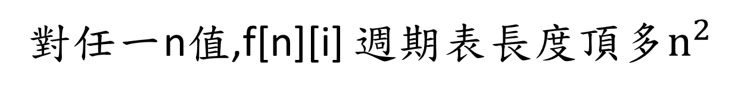
f[n][i] 週期表長度
f(i+2) % n = (f(i+1) + f(i)) % n
頂多n種可能值
對任一n值,f[n][i] 週期表長度頂多$n^{2}$

Slide 22

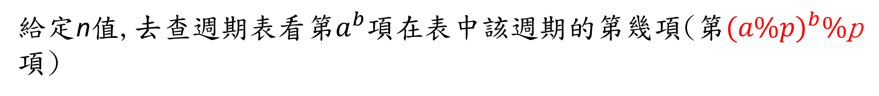

查表法
給定n值,去查週期表看第$a^{b}項在$表中該週期的第幾項(第${(a\%p)}^{b}\%$p項)
$$a^{b} \% p=\left(a∙a∙a⋯a\right) \% p$$
$=[(x_{1}∙p+a\%p)∙(x_{2}∙p+a\%p)∙(x_{3}∙p+a\%p)⋯(x_{b}∙p+a\%p)]\%p$
$=[(a\%p)∙(a\%p)∙(a\%p)⋯(a\%p)]\%p$
$$={(a\%p)}^{b}\%p$$
(很注意計算過程中利用%來壓低數字大小)

Slide 23

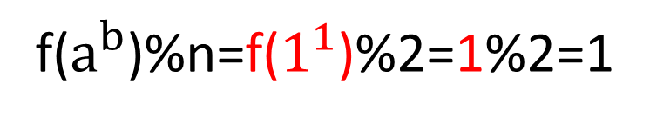
查表法
a=1, b=1, n=2
f($a^{b}$)%n=f($1^{1}$)%2=1%2=1
Example 1
period[n]
f[n][i] :週期表
i
n | 週期長度
2 | 3
3 | 8
4 | 6
5 | 20
 | 0 | 1 | 2 | 3 | 4 | 5 | 6 | 7 | 8 | 9 | 10 | 11 | 12 | 13 | 14 | 15 | 16 | 17 | 18 | 19 | 20
2 | 0 | 1 | 1 | 0
3 | 0 | 1 | 1 | 2 | 0 | 2 | 2 | 1 | 0
4 | 0 | 1 | 1 | 2 | 3 | 1 | 0
5 | 0 | 1 | 1 | 2 | 3 | 0 | 3 | 3 | 1 | 4 | 0 | 4 | 4 | 3 | 2 | 0 | 2 | 2 | 4 | 1 | 0
n
n=2, 週期表長度p=3
週期表第 ${(a\%p)}^{b}\%p={(1\%3)}^{1}\%3=1$項

Slide 24

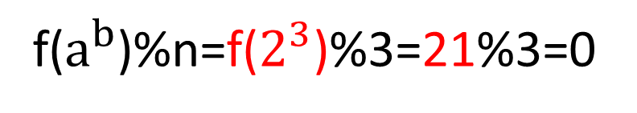
查表法
a=2, b=3, n=3
f($a^{b}$)%n=f($2^{3}$)%3=21%3=0
Example 2
period[n]
f[n][i] :週期表
i
n | 週期長度
2 | 3
3 | 8
4 | 6
5 | 20
 | 0 | 1 | 2 | 3 | 4 | 5 | 6 | 7 | 8 | 9 | 10 | 11 | 12 | 13 | 14 | 15 | 16 | 17 | 18 | 19 | 20
2 | 0 | 1 | 1 | 0
3 | 0 | 1 | 1 | 2 | 0 | 2 | 2 | 1 | 0
4 | 0 | 1 | 1 | 2 | 3 | 1 | 0
5 | 0 | 1 | 1 | 2 | 3 | 0 | 3 | 3 | 1 | 4 | 0 | 4 | 4 | 3 | 2 | 0 | 2 | 2 | 4 | 1 | 0
n
n=3, 週期表長度p=8
週期表第 ${(a\%p)}^{b}\%p={(2\%8)}^{3}\%8=0$項

Slide 25

查表法
a=2, b=5, n=5
f($a^{b}$)%n=f($2^{5}$)%5=2178309%5=4
Example 3
period[n]
f[n][i] :週期表
i
n | 週期長度
2 | 3
3 | 8
4 | 6
5 | 20
 | 0 | 1 | 2 | 3 | 4 | 5 | 6 | 7 | 8 | 9 | 10 | 11 | 12 | 13 | 14 | 15 | 16 | 17 | 18 | 19 | 20
2 | 0 | 1 | 1 | 0
3 | 0 | 1 | 1 | 2 | 0 | 2 | 2 | 1 | 0
4 | 0 | 1 | 1 | 2 | 3 | 1 | 0
5 | 0 | 1 | 1 | 2 | 3 | 0 | 3 | 3 | 1 | 4 | 0 | 4 | 4 | 3 | 2 | 0 | 2 | 2 | 4 | 1 | 0
n
n=5, 週期表長度p=20
週期表第 ${(a\%p)}^{b}\%p={(2\%20)}^{5}\%20=12$項

Slide 26

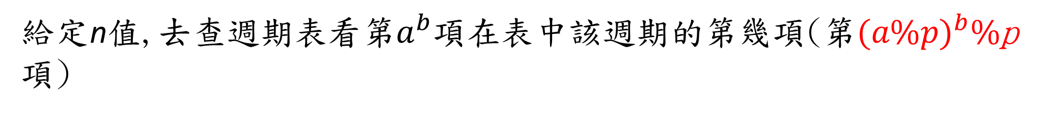
次方計算
給定n值,去查週期表看第$a^{b}項在$表中該週期的第幾項(第${(a\%p)}^{b}\%$p項)
為$了{要有效率計算 (a\%p)}^{b}\%$p 值,使用Recursive squaring方式計算(重點在有效率的計算次方)

Slide 27
Recursive Squaring
We can derive a more efficient linearly recursive algorithm by using repeated squaring:
For example,
2⁴ = 2^{(4/2)2} = (2^{4/2})² = (2²)² = 4² = 16
2⁵ = 2^{1+(4/2)2} = 2(2^{4/2})² = 2(2²)² = 2(4²) = 32
2⁶ = 2^{(6/ 2)2} = (2^{6/2})² = (2³)² = 8² = 64
2⁷ = 2^{1+(6/2)2} = 2(2^{6/2})² = 2(2³)² = 2(8²) = 128.
© 2010 Goodrich, Tamassia
Using Recursion

Slide 28
Recursive Squaring Method
Algorithm Power(x, n):
Input: A number x and integer n = 0
Output: The value x^{n}
if n = 0 then
return 1
if n is odd then
y = Power(x, (n - 1)/ 2)
return x · y ·y
else
y = Power(x, n/ 2)
return y · y
© 2010 Goodrich, Tamassia
Using Recursion
28

Slide 29
Analysis
Algorithm Power(x, n):
Input: A number x and integer n = 0
Output: The value x^{n}
if n = 0 then
return 1
if n is odd then
y = Power(x, (n - 1)/ 2)
return x · y · y
else
y = Power(x, n/ 2)
return y · y
Each time we make a recursive call we halve the value of n; hence, we make log n recursive calls. That is, this method runs in O(log n) time.
It is important that we use a variable twice here rather than calling the method twice.
© 2010 Goodrich, Tamassia
Using Recursion

Slide 30
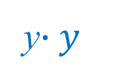


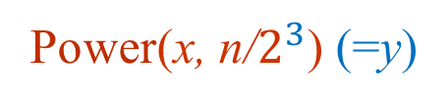
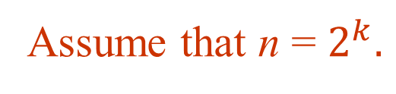
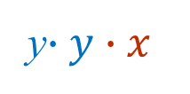



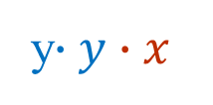
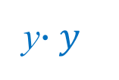

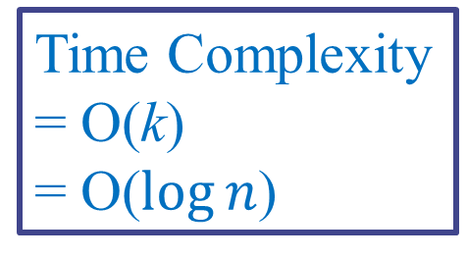
Analysis of Power(x,n)
If n is even
Power(x, n)
depth
Power(x, n/$2^{1}$) (=y)
y$∙y$
1
Power(x, n/$2^{2}$) (=y)
y$∙y∙x$
2
Power(x, n/$2^{3}$) (=y)
y$∙y$
3
Assume that n = $2^{k}.$
$$k= \log_{2}{n}$$
$$⋮$$
$$⋮$$
Time Complexity
= O(k)
= O($\log{n}$)
Power(x, n/$2^{k}$) (=y)
y$∙y∙x$
k

Slide 31
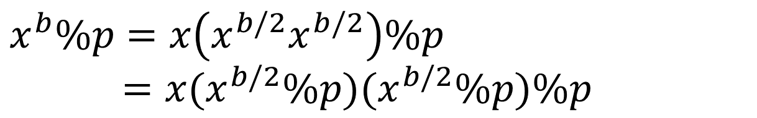
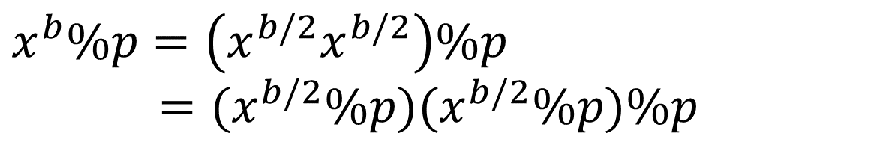
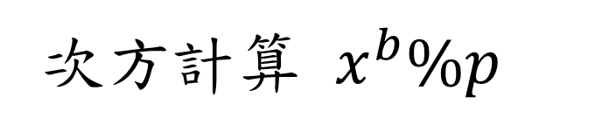
次方計算 $x^{b}\%p$
b 是偶數
$$x^{b}\%p=\left(x^{b/2}x^{b/2}\right)\%p$$
$=(x^{b/2}\%p)(x^{b/2}\%p)\%p$
b 是奇數
$$x^{b}\%p=x\left(x^{b/2}x^{b/2}\right)\%p$$
$=x(x^{b/2}\%p)(x^{b/2}\%p)\%p$

Slide 32
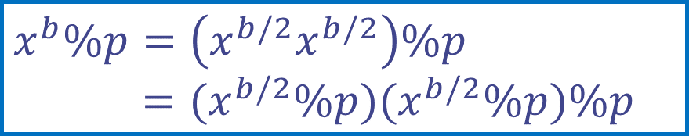

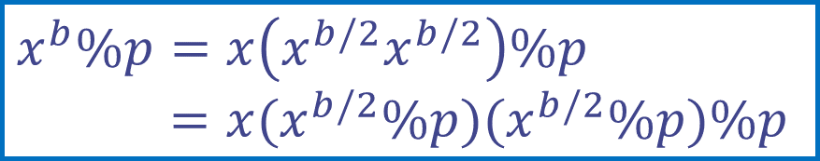
Recursive Squaring Method for Computing ${(a\%p)}^{b}\%$p
Algorithm Pow_mod(x, b, p):
Input: integers x,b ,p // x=a%p
Output: The value x^{b} % p
if b = 0 then
return 1
if b is odd then
y = Pow_mod(x, (b - 1)/ 2,p)
return x · y ·y%p
else
y = Pow_mod(x, b/ 2,p)
return y · y%p
b 是奇數
$$x^{b}\%p=x\left(x^{b/2}x^{b/2}\right)\%p$$
$=x(x^{b/2}\%p)(x^{b/2}\%p)\%p$
b 是偶數
$$x^{b}\%p=\left(x^{b/2}x^{b/2}\right)\%p$$
$=(x^{b/2}\%p)(x^{b/2}\%p)\%p$
© 2010 Goodrich, Tamassia
Using Recursion
32

Slide 33
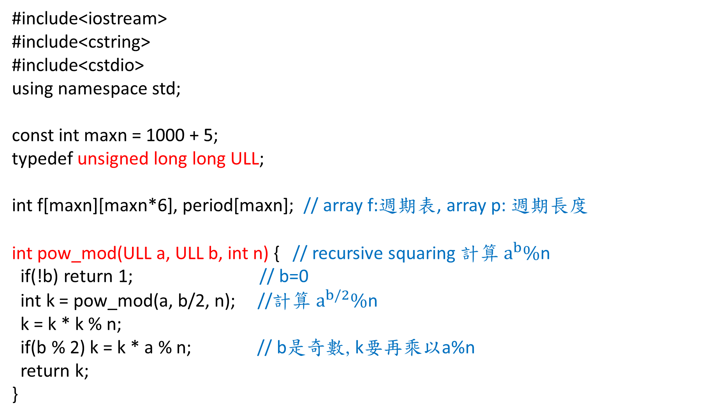
UVa 11582 Code (1/3)
#include<iostream>
#include<cstring>
#include<cstdio>
using namespace std;
const int maxn = 1000 + 5;
typedef unsigned long long ULL;
int f[maxn][maxn*6], period[maxn]; // array f:週期表, array p: 週期長度
int pow_mod(ULL a, ULL b, int n) { // recursive squaring 計算 $a^{b}\%$n
if(!b) return 1; // b=0
int k = pow_mod(a, b/2, n); //計算 $a^{b/2}\%$n
k = k * k % n;
if(b % 2) k = k * a % n; // b是奇數,k要再乘以a%n
return k;
}

Slide 34
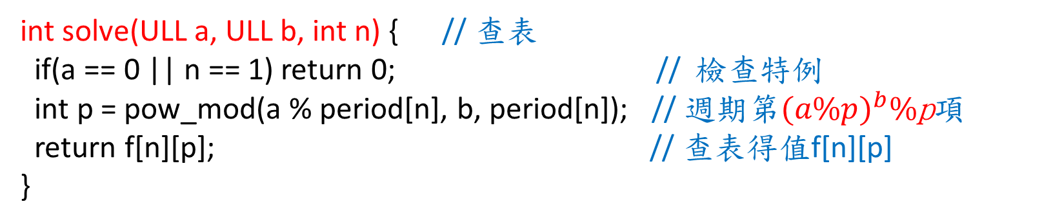
UVa 11582 Code (2/3)
int solve(ULL a, ULL b, int n) { // 查表
if(a == 0 || n == 1) return 0; // 檢查特例
int p = pow_mod(a % period[n], b, period[n]); // 週期第${(a\%p)}^{b}\%$p項
return f[n][p]; // 查表得值f[n][p]
}

Slide 35
UVa 11582 Code (3/3)
int main() {
for(int n = 2; n <= 1000; n++) { // 建立週期表f[n][i]與週期長度period[n]
f[n][0] = 0; f[n][1] = 1;
for(int i = 2; ; i++) {
f[n][i] = (f[n][i-1] + f[n][i-2]) % n; // 由左至右填入週期表
if(f[n][i-1] == 0 && f[n][i] == 1) { period[n] = i - 1; break; }
// 找到了f[n]的週期序列與週期長度i-1
}
}
ULL a, b;
int n, T;
cin >> T;
while(T--) {
cin >> a >> b >> n;
cout << solve(a, b, n) << “\n”; // 輸入a,b,n, 查表找答案solve(a,b,n)
}
return 0;
}

